Slide 1
How the Earth Institute Helped some Mathematicians to Fall in Love with Soil
Lennon Ó Náraigh¹, Graham Benham¹, Saoirse Tracy²
¹ School of Mathematics and Statistics, University College Dublin
² School of Agriculture and Food Science, University College Dublin

Slide 2
History
Networking event in 2021, organized by the Earth Institute
Led to a follow-on seed-funding application
Seed-funding application successful

Slide 3
A Mathematical Model of Soil Compaction I
Water draining through soil is (obviously) a fluid.
Fundamental Equations of Fluid Mechanics apply – 3D Navier-Stokes Equations.
Equations are solved for a particular flow domain with particular boundary conditions.
The flow domain is provided by the pore structure of the soil.

Slide 4
A Mathematical Model of Soil Compaction II
The geometry of the problem can be obtained by scanning soil-core samples in an X-Ray CT scanner.
The scans can be converted into a digital representation (.stl file).
The digital representation provides the domain for a simulation using the Navier-Stokes Equations.
Different levels of soil compaction and soil type lead to different porous medium structures, hence different fluid flows.
Figure 1: Outline of steps used in the subsampling, meshing, and solution of cell problem (a and b). The subsampling of a 1.2 mm side length cube of the segmented .stl file (c). The mesh generation. The generation of a truly periodic geometry through (d) translation and (e) reflection, the original volume mesh is shown in a lighter shade (f). The numerical solution for the local velocity magnitude in the subsampled soil.

Slide 5
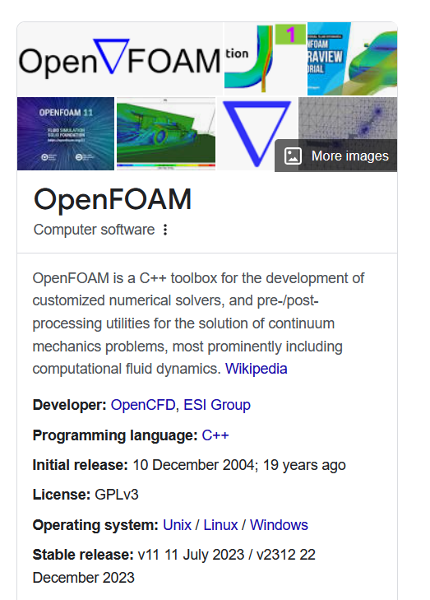
Simulation using Navier-Stokes Equations
Preliminary work carried out by final-year project students and CRT students
Synthetic Geometry
No need to hand-code solutions of Navier-Stokes Equations – use OpenFOAM CFD software instead
Possibly unrealistic flow rates etc.
Proof of concept

Slide 6
After that…
Simulations – other than toy models require a lot of inputs:
Dedicated time and effort
Debugging and implementation on high-end supercomputers
Data visualization
Validation
A focus… not just Colourful Fluid Dynamics
Invitation to participate in VistaMilk Phase II – System of Systems platform

Slide 7
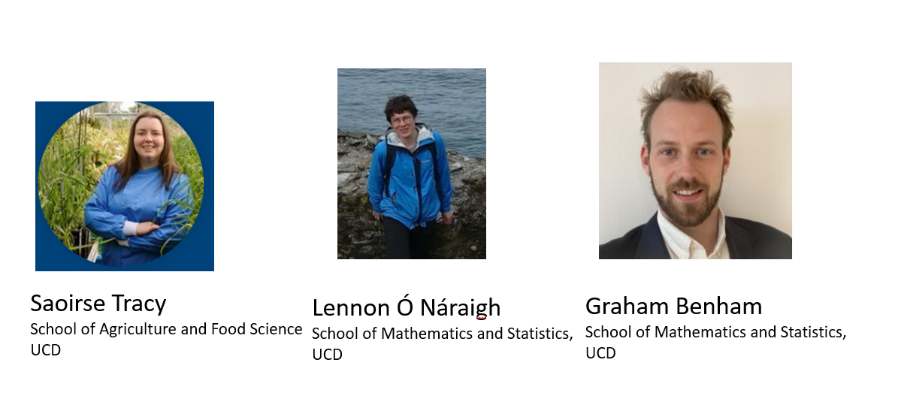
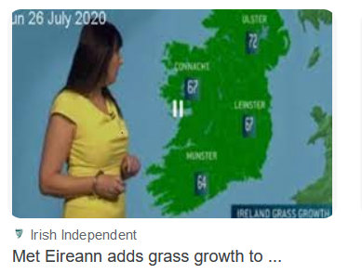
The beginning of our Soil Modelling Group
Our Soil Modelling Group has some very clear targets for VistaMilk II
Develop a new model of soil-moisture deficit (SMD) which accounts for depth effects. This will enhance an already-existing grass-growth forecast model.
Develop new drainage curves using Computational Fluid Mechanics and X-ray CT scanning of soil-core samples which can better inform the model in (1)

Slide 8
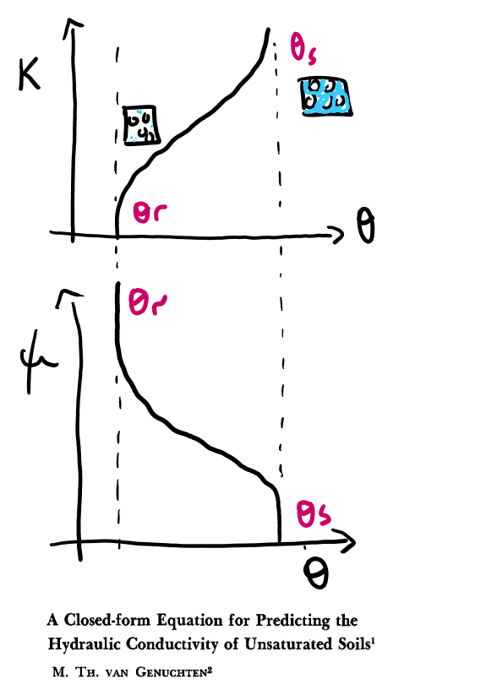
Aim 1: SMD Model
Current SMD model:
$${SMD}_{t}={SMD}_{t−1}−{RAIN}_{t}+{ET}_{t}+{DRAIN}_{t}$$
A PDE(*) in disguise:
$$\frac{∂θ}{∂t}=−\frac{∂}{∂z}\left\{K\left(θ\right)\left[\frac{∂ψ}{∂z}+1\right]\right\}+ET$$
$K\left(θ\right)$ is the hydraulic conductivity and $ψ$ is the capillary pressure.
There are models for these, the parameters depend on the soil type.
Model inputs are daily rainfall and ET curve.
(*) Or Partial Differential Equation. How to get an Applied Mathematician interested
in a topic… falling in love is maybe a bit of an exaggeration.

Slide 9
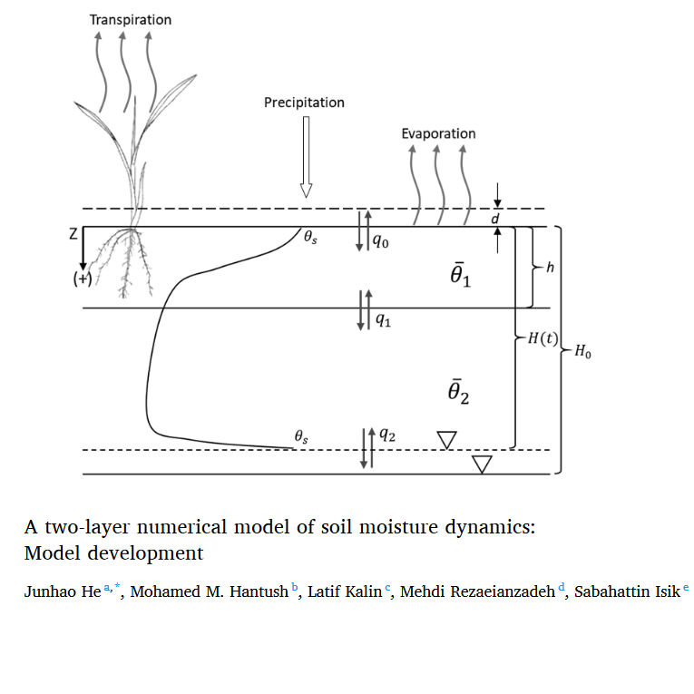
Plan
The PDE is the Richards Equation, it is very challenging to solve numerically (*)
We propose instead to adapt a two-layer depth-averaged version, which can be coupled to the existing grass-growth model to give an improved prediction of the drainage rate.
(*) When the PDE has some issues that make it hard to find a solution, things get interesting.

Slide 10
Aim 2 – Understanding Drainage Curves
This provides a bit of structure to our earlier efforts and gives us the
motivation to bring them to completion:
We will scan soil-core samples and convert them into a digital representation.
The digital representation will then be the domain for a simulation using CFD.
We will use the OpenFOAM simulation software on ICHEC.
The resulting simulation data will give us new insights into the drainage curves, thereby further enhancing the SMD model.
Figure 1: Outline of steps used in the subsampling, meshing, and solution of cell problem (a and b). The subsampling of a 1.2 mm side length cube of the segmented .stl file (c). The mesh generation. The generation of a truly periodic geometry through (d) translation and (e) reflection, the original volume mesh is shown in a lighter shade (f). The numerical solution for the local velocity magnitude in the subsampled soil.

Slide 11
Summary
The Earth Institute is an excellent way to link up researchers in seemingly disparate areas.
Small amounts of funding can lead to bigger things down the line.
But patience is required:
Earth Institute Networking: March 2021
Earth Institute Seed-funding: November 2021
VistaMilk II Launched: May 2024
New SMD model operational: 2027?

