Slide 1



Gravity: Newtonian, post-Newtonian,
Relativistic
Dublin School on Gravitational Wave
Source Modelling
University College Dublin, 11 – 22 June 2018
Cliff
Professor Clifford Will
Distinguished Professor of Physics
University of Florida
Chercheur Associé
Institut d’Astrophysique de Paris
www.phys.ufl.edu/~cmw/
cmw@phys.ufl.edu

Slide 2
Outline of the Lectures*
Part 1: Newtonian Gravity
  Foundations
  Equations of hydrodynamics
  Spherical and nearly spherical bodies
  Motion of extended fluid bodies
Part 2: Newtonian Celestial Mechanics
  Two-body Kepler problem
  Perturbed Kepler problem
*Based on Gravity: Newtonian, post-Newtonian, General Relativistic,
by Eric Poisson and Clifford Will (Cambridge U Press, 2014)

Slide 3
Outline of the Lectures*
Part 3: General Relativity
  Einstein equivalence principle
  GR field equations
Part 4: Post-Newtonian & post-Minkowskian theory
  Formulation
  Near-zone physics
  Wave-zone physics
  Radiation reaction
*Based on Gravity: Newtonian, post-Newtonian, General Relativistic,
by Eric Poisson and Clifford Will (Cambridge U Press, 2014)

Slide 4
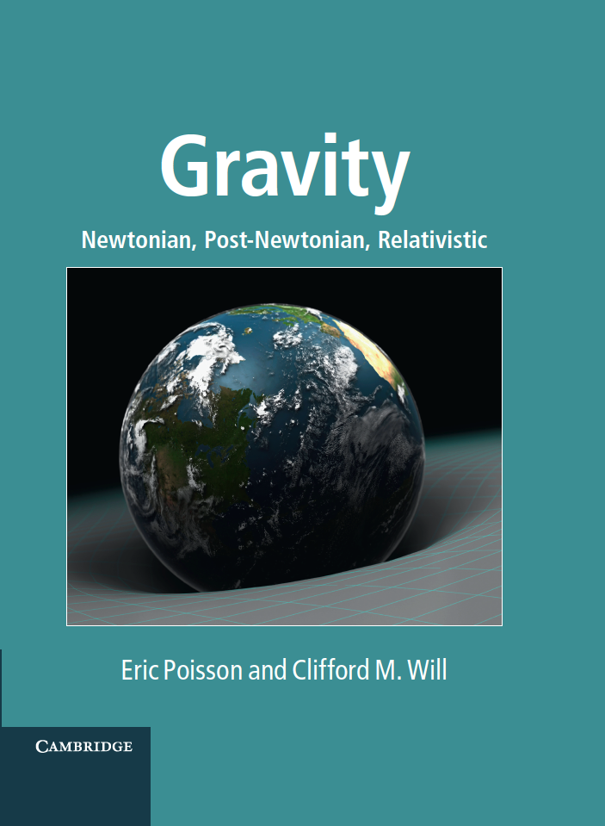

Click here to
skip this ad
*Based on Gravity: Newtonian, post-Newtonian, General Relativistic,
by Eric Poisson and Clifford Will (Cambridge U Press, 2014)

Slide 5
Foundations of Newtonian Gravity
Newton’s 2nd law and the law of gravitation:
The principle of equivalence:
If
Then, comparing the acceleration of two different
bodies or materials

Slide 6
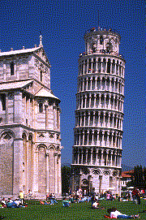
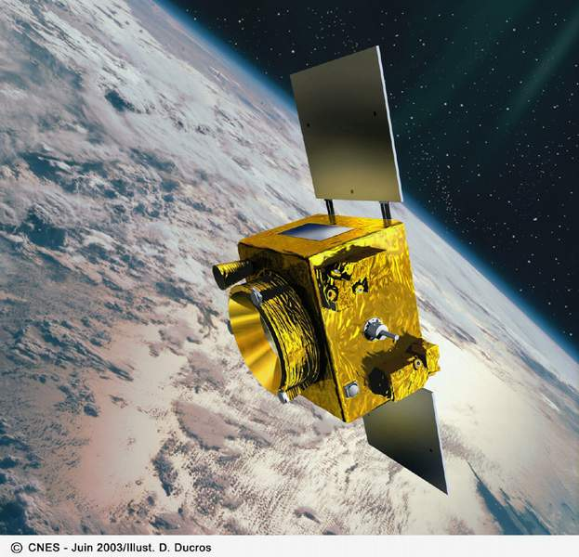
The Weak Equivalence Principle (WEP)
400 CE Ioannes Philiponus: “…let fall from the same height
two weights of which one is many times as heavy as the
other …. the difference in time is a very small one”
1553 Giambattista Benedetti
proposed equality
1586 Simon Stevin
experiments
1589-92 Galileo Galilei
Leaning Tower of Pisa?
1670-87 Newton
pendulum experiments
1889, 1908 Baron R. von Eötvös
torsion balance experiments (10⁻⁹)
1990 – 2010 UW (Eöt-Wash)
10⁻¹³
2010 Atom inteferometers
matter waves vs macroscopic object
2018 MICROSCOPE
10⁻¹⁴ in space
Bodies fall in a gravitational field with an acceleration
that is independent of mass, composition or internal structure

Slide 7
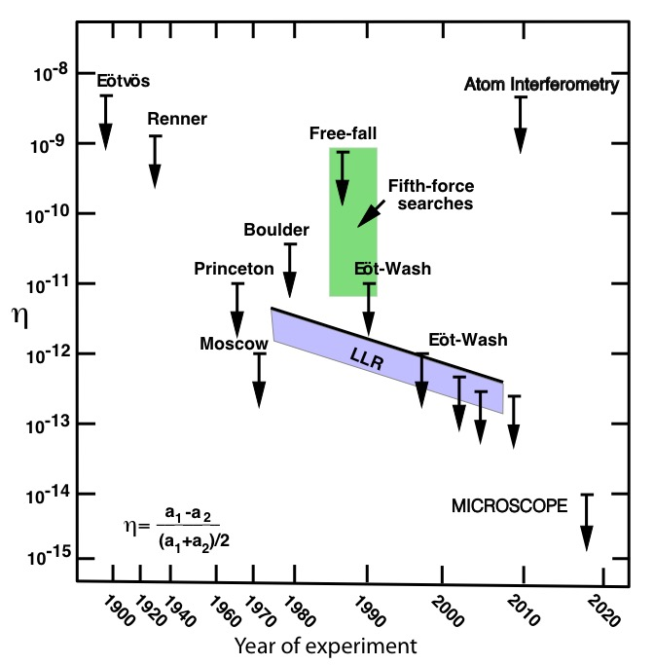
Tests of the Weak Equivalence Principle

Slide 8
Newtonian equations of Hydrodynamics
Writing
Equation of motion
Field equation
Generalize to multiple sources (sum over M’s) and continuous matter
Euler equation of motion
Continuity equation
Poisson field equation
Total or Lagrangian derivative
Equation of state
Formal solution of Poisson’s field equation:
Write
Green function

Slide 9
Rules of the road
Consequences of the continuity equation: for any f(x,t):
Useful rules:

Slide 10
Global conservation laws

Slide 11
Spherical and nearly spherical bodies
Spherical symmetry
Outside the body

Slide 12
Spherical and nearly spherical bodies
Non-spherical bodies: the external field
Taylor expansion:
Then the Newtonian potential outside the body becomes

Slide 13
Symmetric tracefree (STF) tensors
Symmetric on all indices, and
Example: gradients of 1/r
General formula for n^{<L>}:

Slide 14
Symmetric tracefree (STF) tensors
Link between n^{<L>} and spherical harmonics
Average of n^{<L>} over a sphere:

Slide 15
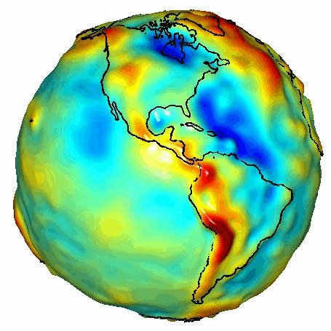
Spherical and nearly spherical bodies
Example: axially symmetric body
e
C
Note that:
A

Slide 16
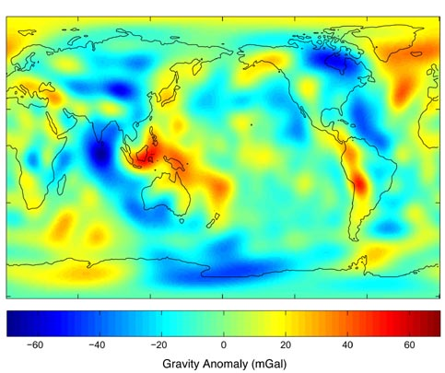
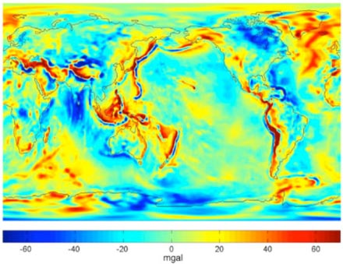
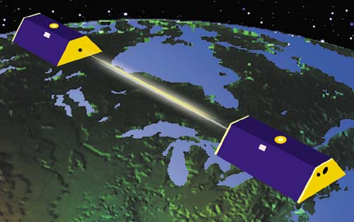
Measuring the Earth’s multipole moments
Gravity Recovery And Climate Experiment (GRACE)
Earth: j₂ = -4.8416932 (5) X 10⁻⁴
j₃ = 9.5721 (1) X 10⁻⁷
j₄ = 5.39994 (4) X 10⁻⁷
……
……
j_{360,0} = 3.2 (5) X 10⁻¹⁰
Earth: j₂ = -4.84 X 10⁻⁴,
j₃ = 9.6 X 10⁻⁷,
j₄ = 5.4 X 10⁻⁷, …
1 mGal ≈ 10⁻⁶ g

Slide 17
Motion of extended fluid bodies
Main assumptions:
Bodies small compared to typical separation (R << r)
“isolated” -- no mass flow
T_{int} ~ (R³/Gm)^{1/2} << T_{orb} ~ (r³/Gm)^{1/2} -- quasi equilibrium
adiabatic response to tidal deformations -- nearly spherical
External problem:
determine motions of bodies as functions (or functionals) of internal parameters
Internal problem:
given motions, determine evolution of internal parameters
Solve the two problems self-consistently or iteratively
Example: Earth-Moon system -- orbital motion
raises tides, tidally deformed fields affect
motions

Slide 18
Motion of extended fluid bodies
Basic definitions
Is the center of mass unique?
pure convenience, should not wander outside the body
not physically measurable
almost impossible to define in GR
Define:

Slide 19
Motion of extended fluid bodies
N-body point mass
terms
Moments of
other bodies
Effect of body’s
own moments
Moment-moment
interaction terms
Two-body system with only body 2 having non-zero I^{<L>}

Slide 20
The two-body Kepler problem
set center of mass at the origin (X = 0)
ignore all multipole moments (spherical bodies or point masses)
define
reduces to effective one-body problem
Energy and angular momentum conserved:
orbital plane
is fixed

Slide 21
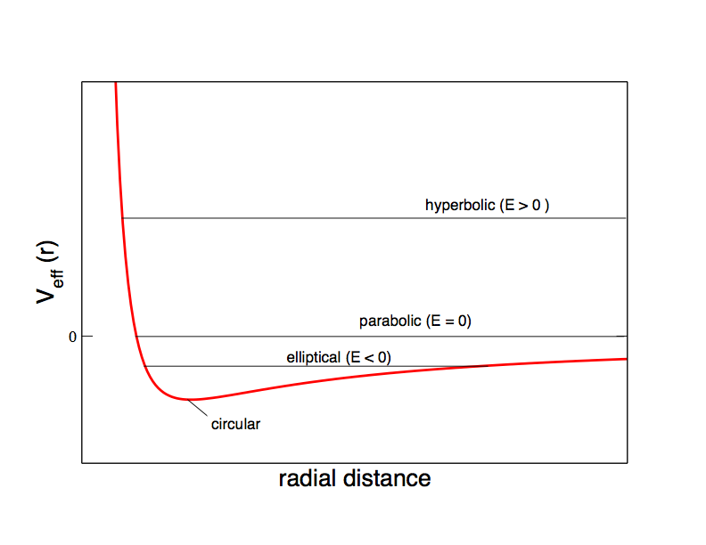
Effective one-body problem
Make orbital plane the x-y plane
y
λ=dn/dφ
r
n
φ
From energy conservation:
x
Reduce to quadratures (integrals)

Slide 22
Keplerian orbit solutions
Radial acceleration, or d/dt of energy equation:
Find the orbit in space: convert from t to φ:
Elliptical orbits (e < 1, a > 0)
Hyperbolic orbits (e > 1, a < 0)

Slide 23
Keplerian orbit solutions
Useful relationships
for closed orbits
Alternative solution
u = eccentric anomaly
f = true anomaly
n = mean motion

Slide 24
Dynamical symmetry in the Kepler problem
a and e are constant (related to E and h)
orbital plane is constant (related to direction of h)
ω is constant -- a hidden, dynamical symmetry
Runge-Lenz vector
Comments:
responsible for the degeneracy of hydrogen energy levels
added symmetry occurs only for 1/r and r² potentials
deviation from 1/r potential generically causes dω/dt

Slide 25
Outline of the Lectures*
Part 1: Newtonian Gravity
  Foundations
  Equations of hydrodynamics
  Spherical and nearly spherical bodies
  Motion of extended fluid bodies
Part 2: Newtonian Celestial Mechanics
  Two-body Kepler problem
  Perturbed Kepler problem
*Based on Gravity: Newtonian, post-Newtonian, General Relativistic,
by Eric Poisson and Clifford Will (Cambridge U Press, 2014)

Slide 26
Keplerian orbit in space
Six orbit elements:
i = inclination relative to reference plane:
Ω = angle of ascending node
ω = angle of pericenter
e = |A|
a = h^2/Gm(1-e²)
T = time of pericenter passage
z
Orbit plane
n
h
f
λ
ω
y
Reference plane
i
x
Ω
Comment: equivalent to the initial conditions x₀ and v₀

Slide 27
Osculating orbit elements and the perturbed Kepler problem
Same
x & v
Define:
osculating orbit
actual orbit
new osculating
orbit
e, a, ω, Ω, i, T may be functions of time

Slide 28
Perturbed Kepler problem
Decompose:
Example:

Slide 29
Perturbed Kepler problem
“Lagrange planetary equations”
An alternative pericenter angle:

Slide 30
Perturbed Kepler problem
Comments:
these six 1st-order ODEs are exactly equivalent to the original
three 2nd-order ODEs
if f = 0, the orbit elements are constants
if f << Gm/r², use perturbation theory
yields both periodic and secular changes in orbit elements
can convert from d/dt to d/df using
Drop if working to
1st order

Slide 31
Perturbed Kepler problem
Worked example: perturbations by a third body
3
r₂₃
r₁₃
r=r₁₂
2
1
Put third body on a circular orbit

Slide 32
Perturbed Kepler problem
Worked example: perturbations by a third body
Integrate over f from 0 to 2π holding F fixed, then average over F from 0 to 2π:
Also:

Slide 33
Perturbed Kepler problem
Worked example: perturbations by a third body
Case 1: coplanar 3rd body and Mercury’s perihelion (i = 0)
For Jupiter:
For Earth

Slide 34
Mercury’s Perihelion: Trouble to Triumph
1687 Newtonian triumph
1859 Leverrier’s conundrum
1900 A turn-of-the century crisis
575 “
per
century

Slide 35
Perturbed Kepler problem
Worked example: perturbations by a third body
Case 2: the Kozai-Lidov mechanism
Stationary point:
A conserved quantity:
L_{Z} !

Slide 36
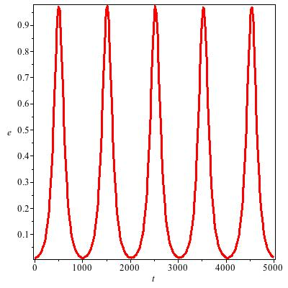
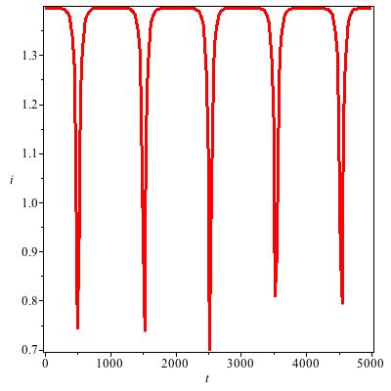
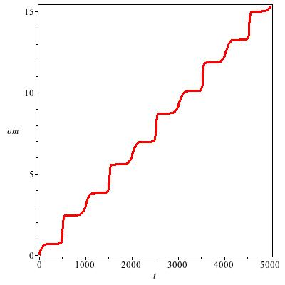
Perturbed Kepler problem
Worked example: perturbations by a third body
Case 2: the Kozai-Lidov mechanism
Eccentricity
Inclination
Pericenter

Slide 37
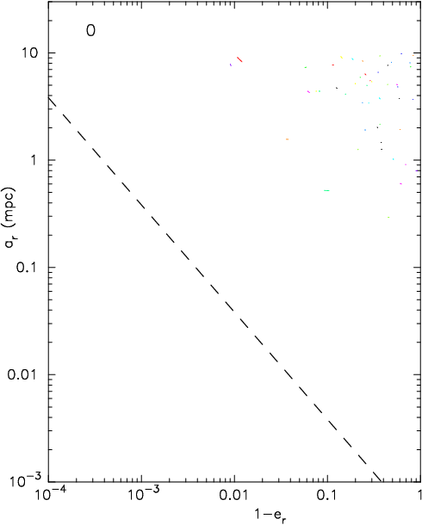

Perturbed Kepler problem
Worked example: perturbations by a third body
Capture by BH
Merritt, Alexander, Mikkola & Will, PRD 84, 044024 (2011)
Animations courtesy David Merritt

Slide 38
Perturbed Kepler problem
Worked example: body with a quadrupole moment
For Mercury (J₂ = 2.2 X 10⁻⁷)
For Earth satellites (J₂ = 1.08 X 10⁻³)
LAGEOS (a=1.93 R, i = 109º.8): 120 deg/yr !
Sun synchronous: a= 1.5 R, i = 65.9

Slide 39
Outline of the Lectures*
Part 3: General Relativity
  Einstein equivalence principle
  GR field equations
Part 4: Post-Newtonian & post-Minkowskian theory
  Formulation
  Near-zone physics
  Wave-zone physics
  Radiation reaction
*Based on Gravity: Newtonian, post-Newtonian, General Relativistic,
by Eric Poisson and Clifford Will (Cambridge U Press, 2014)

Slide 40
The Einstein Equivalence Principle
Test bodies fall with the same acceleration
  Weak Equivalence Principle (WEP)
In a local freely falling frame, physics (nongravitational) is independent of frame’s velocity
  Local Lorentz Invariance (LLI)
In a local freely falling frame, physics (non-gravitational) is independent of frame’s location
  Local Position Invariance (LPI)
EEP => Metric theory of gravity η_{μν} locally -> symmetric g_{μν} “comma” -> “semicolon” Gravity = Geometry

Slide 41
“Curved spacetime tells matter how to move”
2
Euler-Lagrange equations (using τ as parameter):
Christoffel symbols
1
“Gradient” of a vector
A geodesic parallel transports its own tangent vector

Slide 42
“Curved spacetime tells matter how to move”
Continuous matter, stress energy tensor
Perfect fluid:
ρ = rest mass density
= energy density
p = pressure
u^{α} = four velocity
1st law of Thermodynamics
Relativistic Euler equation
Compare with Newton

Slide 43
“Matter tells spacetime how to curve”
Riemann tensor
Ricci tensor
Ricci scalar
Einstein tensor
Bianchi identities
Action
Einstein’s equations:

Slide 44
Landau-Lifshitz Formulation of GR
Post-Newtonian and post-Minkowskian theory start with the Landau-Lifshitz
formulation
Define the “gothic” metric density
Then Einstein’s equations can be written in the form
Antisymmetry of H^{αμβν} implies the conservation equation

Slide 45
Landau-Lifshitz Formulation of GR
Conservation equation allows the formulation of global conservation laws:
Similar conservation laws for linear momentum, angular momentum, and
motion of a center of mass, with

Slide 46
Landau-Lifshitz Formulation of GR
Define potentials
Impose a coordinate condition (gauge): Harmonic or deDonder gauge
Matter tells spacetime how to curve
Spacetime tells matter how to move
Still equivalent to the exact Einstein equations

Slide 47
The “Relaxed” Einstein Equations
Solve for h as a functional of matter variables
Solve for evolution of matter variables to give h(t,x)

Slide 48
Iterating the “Relaxed” Einstein Equations
Assume that h^{αβ} is “small”, and iterate the relaxed equation:
Start with h₀ = 0 and truncate at a desired N
Yields an expansion in powers of G, called a post-Minkowskian expansion
Find the motion of matter using

Slide 49
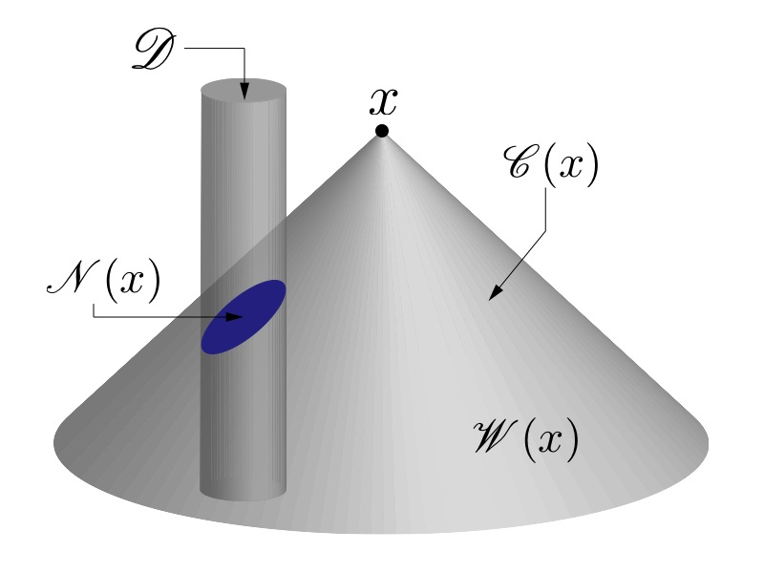
Solving the “Relaxed” Einstein Equations

Slide 50
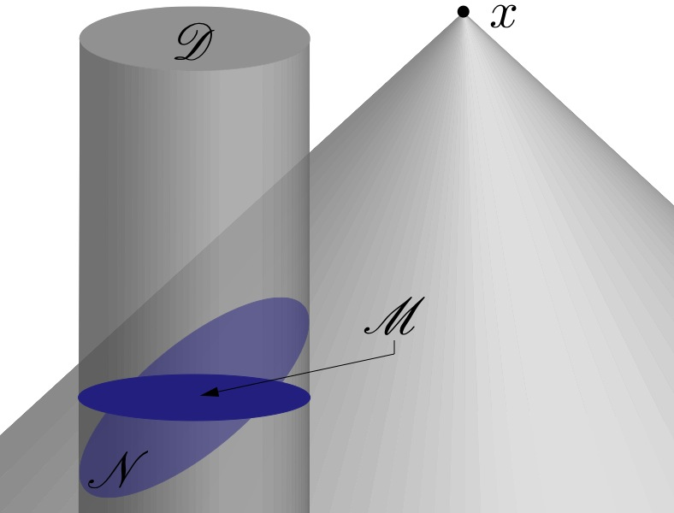
Solving the “Relaxed” Einstein Equations:
Far zone
Near zone integral:
For x >> x’, Taylor expand |x-x’|
A multipole expansion
Integrals depend on R

Slide 51
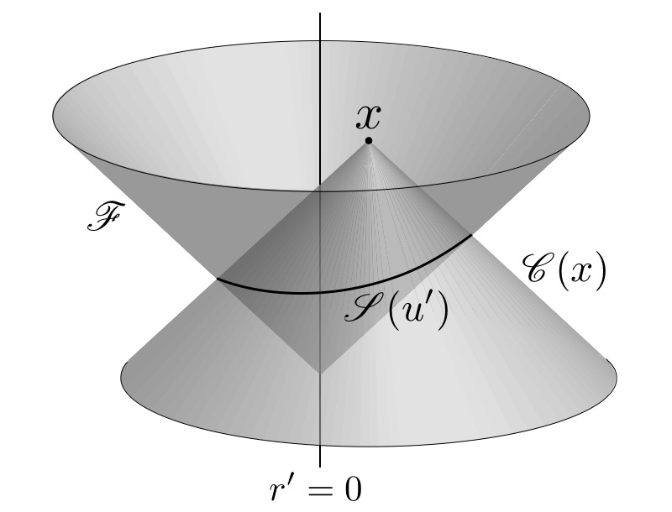
Solving the “Relaxed” Einstein Equations:
Far zone
Far zone integral:
Since contributions to μ in the far zone come from retarded fields, they
have the generic form
Change variables from (r’, θ’, φ’)
to (u’, θ’, φ’), where u’ = cτ’ = ct’-r’

Slide 52
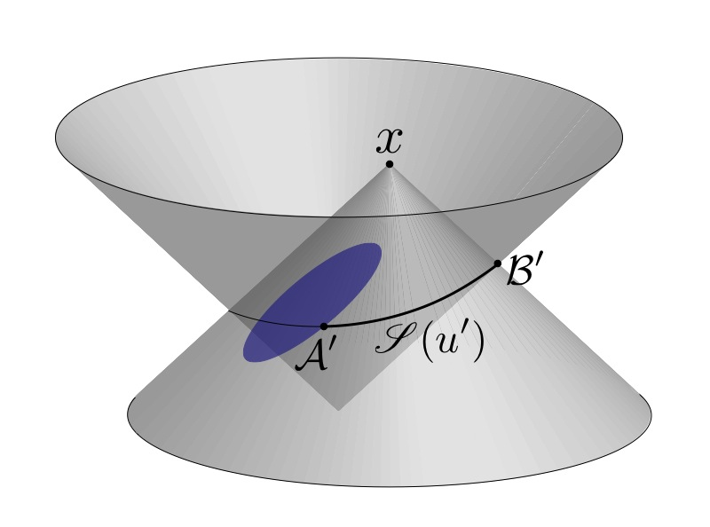
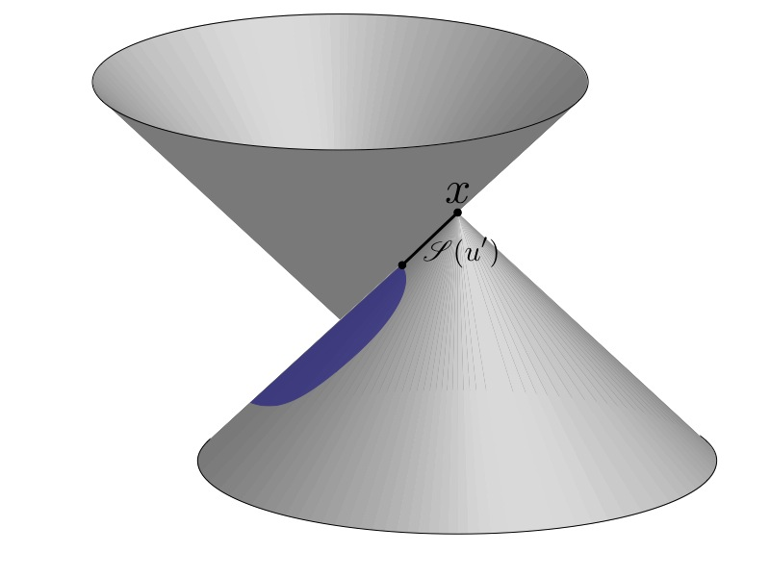
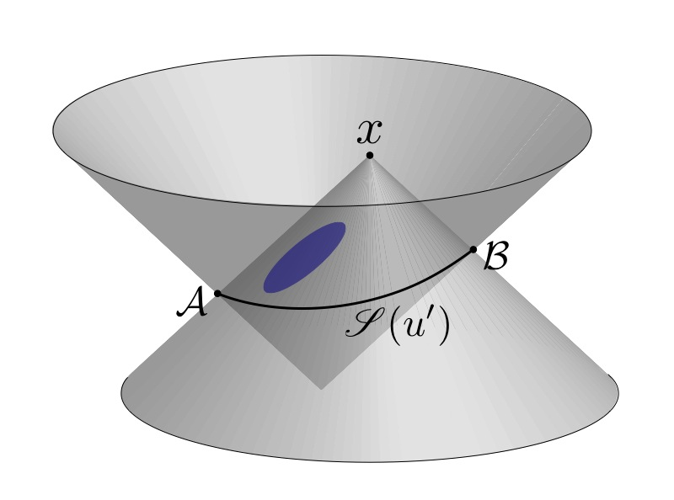
Solving the “Relaxed” Einstein Equations:
Far zone
Far zone integral:
Integral also depends on R
But
is independent of R

Slide 53
Gravity as a source of gravity
and gravitational “tails”

Slide 54
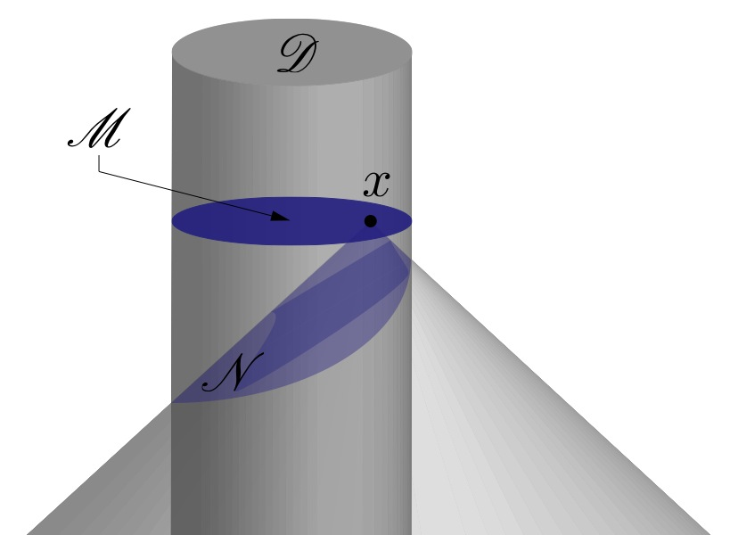
Solving the “Relaxed” Einstein Equations:
Near zone
Near zone integral:
For x ~ x’, Taylor expand about t
A post-Newtonian expansion
in powers of 1/c
Instantaneous potentials
Must also calculate the far-zone
integral

Slide 55
Near zone physics; Motion of
extended fluid bodies
Matter variables:
Slow-motion assumption v/c << 1:

Slide 56
Post-Newtonian approximation: Near zone
Recall the action for a geodesic
ε
ε²
ε²
ε
ε²
We need to calculate
Two iterations of the relaxed
equations required

Slide 57
Post-Newtonian limit of general relativity
b
g

Slide 58
Bounds on the PPN Parameters
Parameter | Effect or Experiment | Bound | Remarks
γ - 1 | Time delay | 2.3 X 10⁻⁵ | Cassini tracking
 | Light deflection | 2 X 10⁻⁴ | VLBI
β - 1 | Perihelion shift | 2.5 X 10⁻⁵ | J₂ = 2.4 X 10⁻⁷
 | Nordtvedt effect | 2.3 X 10⁻⁴ | LLR, η < 3 X 10⁻⁴
ξ | Spin Precession | 4 X 10⁻⁹ | Millisecond pulsars
α₁ | Orbit polarization | 10⁻⁴ | LLR
 |  | 4 X 10⁻⁵ | Pulsar J 1738+0333
α₂ | Spin precession | 2 X 10⁻⁹ | Millisecond pulsars
α₃ | Self-acceleration | 4 X 10⁻²⁰ | Pulsar spindown
ζ₁ | -- | 2 X 10⁻² | Combined bounds
ζ₂ | Binary acceleration | 4 X 10⁻⁵ | PSR 1913+16
ζ₃ | Newton’s 3rd law | 10⁻⁸ | Lunar acceleration
ζ₄ | -- |  | Not independent
η=4β-y-3-10ξ/3-α₁+2α₂/3-2ζ₁/3-ζ₂/3
Bound on scalar-tensor gravity: ω > 40,000

Slide 59
Post-Newtonian Hydrodynamics
From
Post-Newtonian equation of hydrodynamics

Slide 60
N-body equations of motion
Main assumptions:
Bodies small compared to typical separation (R << r)
“isolated” -- no mass flow
ignore contributions that scale as R^{n}
assume bodies are reflection symmetric
B
A
C

Slide 61
N-body equations of motion

Slide 62
N-body equations of motion
Dependence on internal structure?
Use the virial theorem:
Then all structure integrals can be absorbed into a single “total” mass:
This is a manifestation of the Strong Equivalence Principle, satisfied
by GR, but not by most alternative theories.
The motions of all bodies, including NS and BH, are independent of
their internal structure – in GR!

Slide 63
N-body equations of motion

Slide 64
N-body equations of motion:
Worked example: 2 bodies
Define:

Slide 65
PN 2-body equations of motion:
conserved quantities
Conserved energy: dot v into the equation of motion

Slide 66
PN 2-body equations of motion:
conserved quantities
Conserved energy: dot v into the equation of motion

Slide 67
N-body equations of motion:
Worked example: 2 bodies and the perihelion shift
Components of the disturbing force
42.98 “/c for Mercury
4.226598 ^{O}/yr for PSR 1913+16
Integrate the Lagrange planetary equations:

Slide 68
Mercury’s Perihelion: Trouble to Triumph
1687 Newtonian triumph
1859 Leverrier’s conundrum
1900 A turn-of-the century crisis
575 “
per
century

Slide 69
PN theory: Far-zone physics
Recall the wave-zone solution to
Must add the integral over the wave zone
For the field h^{αβ} :

Slide 70
General form of wave-zone fields
M₀
M₀X^{k} = 0

Slide 71
General form of wave-zone fields
P^{j} = 0

Slide 72
General form of wave-zone fields

Slide 73
General form of wave-zone fields
In the far-away wave-zone, keep only 1/r terms

Slide 74
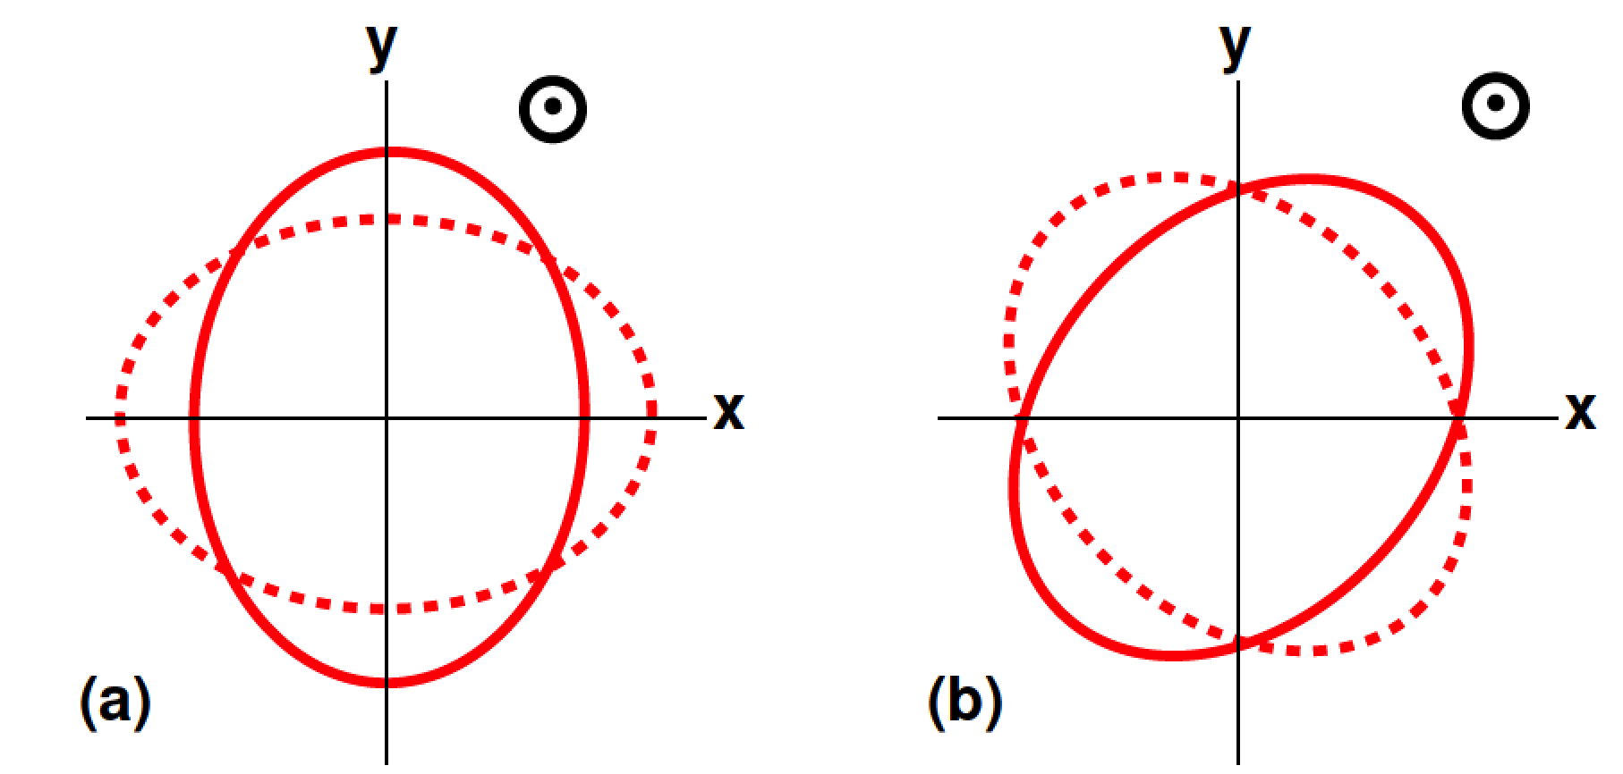
Wave Zone Physics: Gravitational Waves
Geodesic deviation:
u
In the rest frame of an observer
ξ

Slide 75
Wave Zone Physics: Gravitational Waves
The quadrupole formula:
Requires two iterations of the relaxed Einstein equation:
in the far wave-zone
For an N-body system
By convention, the quadrupole formula is called the ``Newtonian’’-order result
Higher order PN corrections can be calculated by further iterating the relaxed equations
3 iterations needed for 1 & 1.5 PN order, 4 for 2PN order etc

Slide 76
Wave Zone Physics: Gravitational Waves
Beyond the quadrupole formula:
For a binary system in a circular orbit:

Slide 77
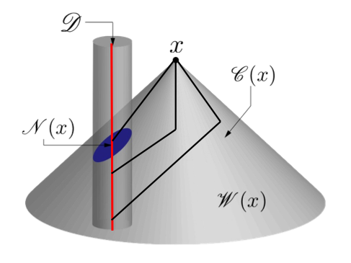
Wave Zone Physics: Gravitational Waves
Beyond the quadrupole formula:
Shapiro time delay

Slide 78
Wave Zone Physics: Energy flux
Called the quadrupole formula for energy flux
Also known as the “Newtonian” order contribution
Also a flux of angular momentum dJ/dt and of linear momentum dP/dt
For a 2-body system:

Slide 79
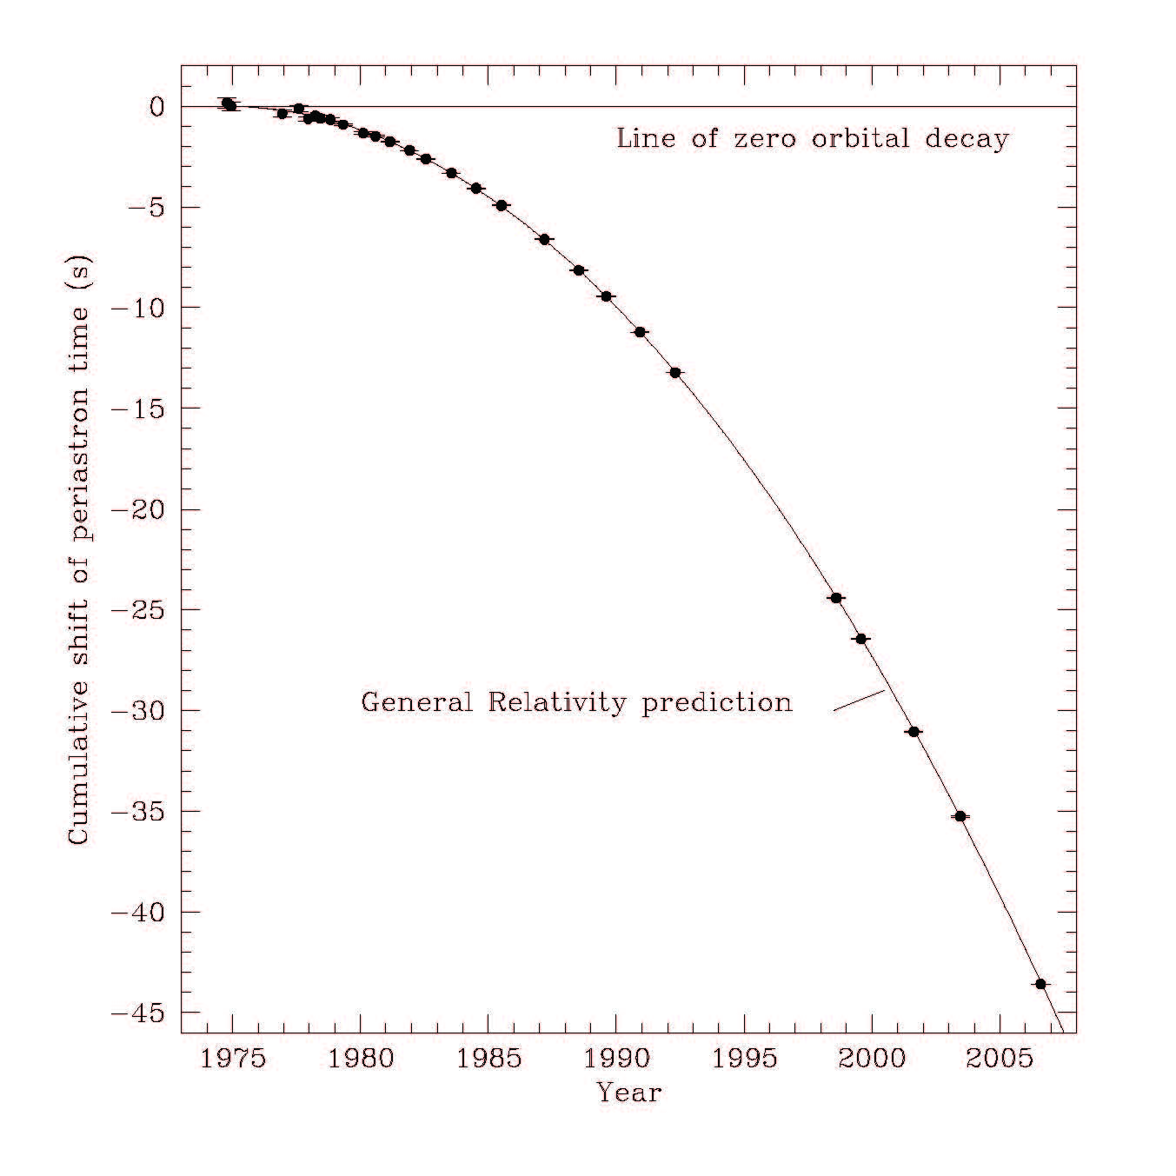
Energy flux and binary pulsars
Orbit-averaged flux
Period decrease
“Newtonian” GW flux
2.5 PN correction to Newtonian equations of motion
PN corrections can be calculated, now reaching 4 PN order
PSR 1913+16
Hulse-Taylor binary pulsar

Slide 80
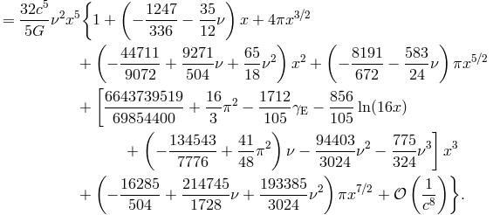
Energy flux and GW interferometers
For a circular orbit, to 3.5 PN order:
From Blanchet, Living Reviews in Relativity 17, 2 (2014)

Slide 81
Wave Zone Physics: Radiation reaction
Loss of energy at order c⁻⁵ implies that the dynamics of a system cannot be conservative at 2.5 PN order
There must be a radiation reaction force F that dissipates energy
according to
To find this force, we return to the near-zone and iterate the relaxed Einstein equations 3 times to find the metric to 2.5 PN order
That metric is inserted into the equations of motion
There are Newtonian, 1 PN, 2 PN, 2.5 PN, …. terms (no 1.5 PN!)
Happily, to find the leading 2.5 PN contributions, it is not necessary to calculate the 2 PN terms explicitly (though that has been done)

Slide 82
Wave Zone Physics: Radiation reaction
Newtonian plus corrections up to 2.5 PN order within τ⁰⁰
Illustration: expand h⁰⁰ in the near zone:
1 PN correction d²X/dt²
No 0.5 PN term: conservation of M
2 PN term
Pure function of time – a coordinate effect
2.5 PN term

Slide 83
Wave Zone Physics: Radiation reaction
Pulling all the contributions together, we find the equations of hydrodynamics to 2.5 PN order
Where f is a radiation reaction force density. For body A
For a 2-body system, this leads to a radiation-reaction contribution
This is harmonic gauge (also called Damour-Deruelle gauge)

Slide 84
Wave Zone Physics: Radiation reaction
Alternative gauge: the Burke-Thorne gauge. All RR effects embodied in a modification of the Newtonian potential
For a two body system
In any gauge, orbital damping precisely matches wave-zone fluxes:

Slide 85
Wave Zone Physics: Radiation reaction
Inserting a_{RR} into the Lagrange planetary equation as a disturbing force and integrating over an orbit
p=a(1-e²)
Radiation reaction causes 2-body orbits to inspiral and circularize
The Hulse-Taylor binary pulsar will circularize and merge within 300 Myr; the double pulsar within 85 Myr
This is short compared to the age of galaxies (5 – 10 Gyr)
There must be NS-NS binaries merging today (possibly even NS-BH and BH-BH binaries)
The detection of both BH-BH and NS-NS mergers confirms this basic picture

Slide 86

The problem of motion and radiation
in general relativity:
The crests
and the troughs
Hokusai ~1830

Slide 87
Motion: the early years
Geodesic motion
1916 - Droste & De Sitter - n-body equations of motion
1918 - Lense & Thirring - motion in field of spinning body
1937-38 - center-of-mass acceleration
(Levi-Civita/Eddington-Clark)
1938 - EIH paper
1960s - Fock & Chandrasekhar - PN approximation
1967 - the Nordtvedt effect
1974 - numerical relativity - BH head-on collision (Smarr et al)
1974 - discovery of PSR 1913+16

Slide 88
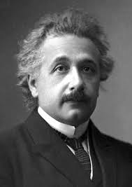
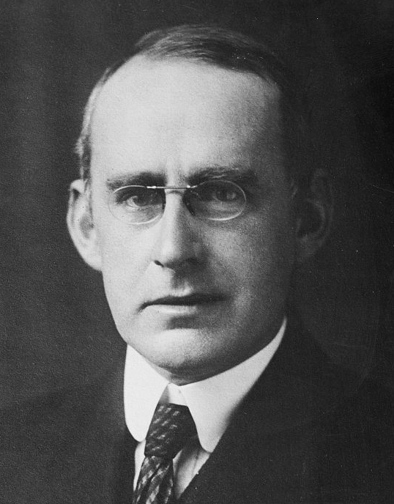
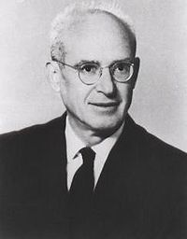
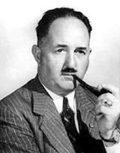
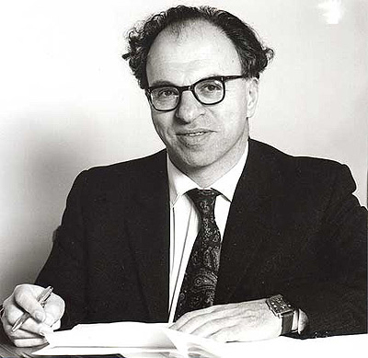
Waves: the early years
?
Einstein 1916 & 18
Eddington 1920
H. P. Robertson
Einstein & Rosen 1936
Hermann Bondi 1950s

Slide 89
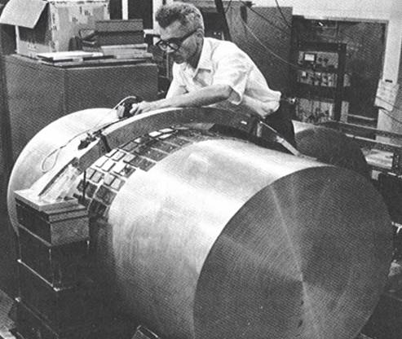
Detection of waves: the early years
Joseph Weber 1970

Slide 90
Joseph Weber & gravitational waves:
Case study in how science works
Joe Weber (1919-2000)
pioneer in electronics, masers and lasers
1959 - learned GR, began building GW detectors
1969 - reported coincident events in detectors 1000 km apart
1971 - more events when bars were perpendicular to galactic center
strength of signals 1000 times stronger than anybody expected
1970s - spurred theoretical work on black holes, neutron stars, supernovas
  could not explain Weber’s events
1970s - spurred other groups to build detectors of better sensitivity
  no events detected
1980 - consensus developed - no GW seen directly by Weber
1980 - 2004 - work on advanced “Weber bars” continued
mid 1980s - plans developed for large “laser interferometer” observatories
1994 - 1999 - construction of LIGO
2002 - LIGO’s first science run
2003 - 2008 - Weber bar detectors phased out

Slide 91
The problem of motion & radiation
1974 - numerical relativity - BH head-on collision
1974 - discovery of PSR 1913+16
Abraham-Lorentz-Dirac force (SR/E&M)
- pre acceleration, retarded vs advanced, runaway solutions,
“point charge” renormalization
Does a freely falling charge on Earth radiate?
Does a charge at rest on Earth radiate?
Does a binary system radiate GW?
- most said yes
- Einstein wasn’t sure
- Havas and others said no
Does a binary system suffer radiation reaction?
- beginnings of understanding (eg matched asymptotic
expansions)

Slide 92


The problem of motion & radiation
1974 - numerical relativity - BH head-on collision
1974 - discovery of PSR 1913+16
1976 - Ehlers et al - critique of foundations
of EOM and RR
1976 - PN corrections to gravitational waves
(EWW)
1978 – re-examination of EOM & RR
divergences

Slide 93
The problem of motion & radiation
1974 - numerical relativity - BH head-on collision
1974 - discovery of PSR 1913+16
1976 - Ehlers et al - critique of foundations
of EOM and RR
1976 - PN corrections to gravitational waves
(EWW)
1978 – re-examination of EOM & RR
1979 - measurement of damping of
binary pulsar orbit
divergences

Slide 94
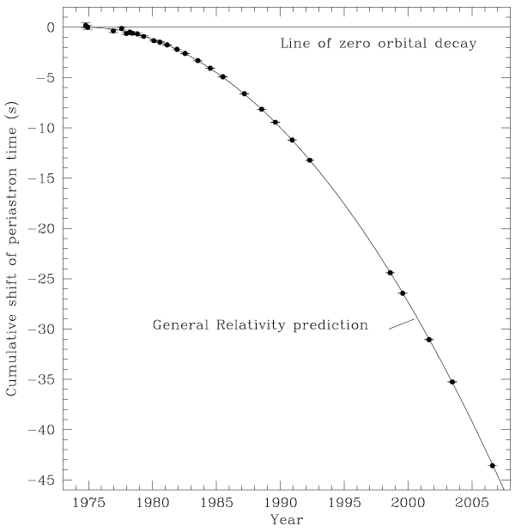
PN Theory and binary pulsars
The Hulse-Taylor
binary pulsar
From Weisberg
Nice & Taylor (2010)

Slide 95
The problem of motion & radiation
1974 - numerical relativity - BH head-on collision
1974 - discovery of PSR 1913+16
1976 - Ehlers et al - critique of foundations
of EOM and RR
1976 - PN corrections to gravitational waves
(EWW)
1978 – re-examination of EOM & RR
1979 - measurement of damping of
binary pulsar orbit
1990 - EOM and gravitational waves to HIGH PN order
  driven by requirements for GW detectors
  many methods: MPPM, DIRE, Jena, Futamase, EFT, ….
2005 – binary black hole breakthrough
divergences

