Slide 1
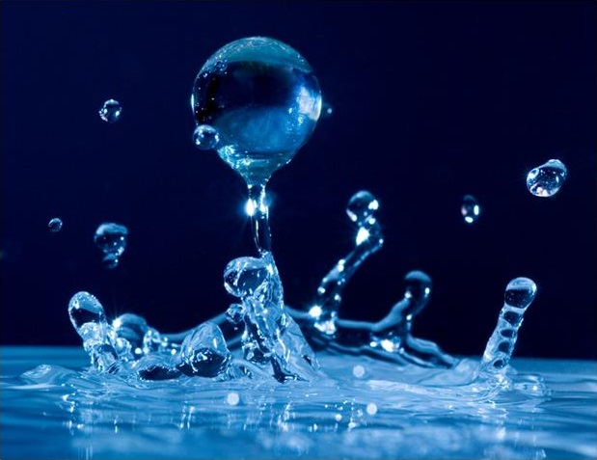
Droplet Impact Modelling
By Joseph Anderson
With Supervisor:
Lennon Ó’Náraigh
UCD School of Mathematics & Statistics
July 2024

Slide 2
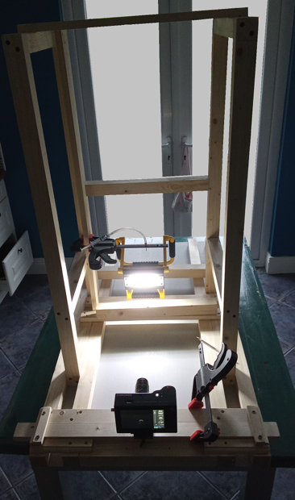
Contents
During the presentation I’m going to discuss:
Why we study droplet impacts?
Past work that has been carried out by students.
Main aims of my project.
Experiment I carried out.
Some theory behind how the OpenFoam simulations work.
Set-up of my simulation.
Show previous students' simulations.
Talk about the Sonic HPC.
Go into my simulations.
Briefly talk about the maximum spreading.
Summarise what we achieved and how it could be furthered.
Experimental setup

Slide 3
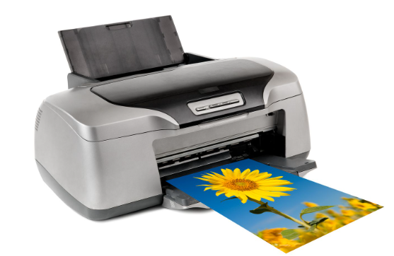
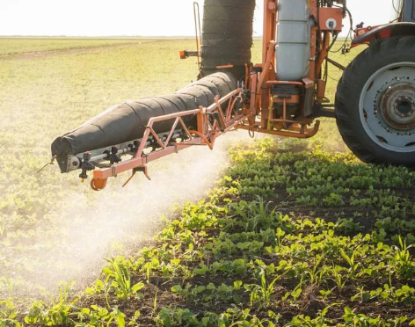
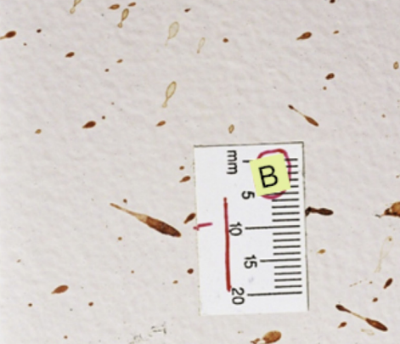
Why study droplet impacts?
Droplet impacts have a large range of practical applications such as:
Ink-jet Printing
Crop Spraying
Forensic Science
The understanding of droplet behaviour can help to produce high-resolution prints without irregularities.
Researching droplet impacts can improve the efficiency of spraying fertilizer on crops.
The analysis of blood stains could reveal useful information about the previous conditions of a crime scene.

Slide 4
Introduction
Contact Angles
Previous Work
We can look at a water droplet falling onto a flat surface.
The contact line is a triple point where the air, water and surface all meet.
In this work we will focus on the contact angle $θ$. There are 2 implementation of the contact angle in OpenFoam:
Constant: Remains constant with time.
Dynamic: Changes with time.
Previous students have completed projects involving droplet impacts.
Juan Mairal (Msc 2020/21)
Created a 2D simulation of a water droplet impact in Openfoam.
Compared results for both constant contact angle and dynamic contact angle.
Looked at the effect $U_{θ}$ on the 2D simulations.
Conor Quigley (Bsc 23/24)
Constructed a 3D simulation of a water droplet impacting a surface.
Compared the model qualitatively with results from an experiment.
Looked at the time dependence of the initial spreading of the droplet.

Slide 5
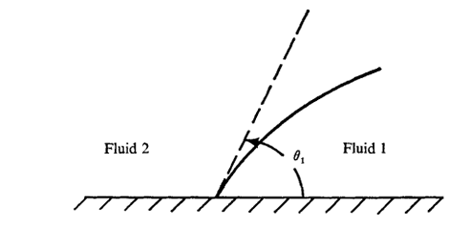
Project Aims
The overall goal of this research was to move towards a more realistic simulation of a droplet impact. This would require 2 key steps:
Experiment Data
Accurately measure the outer edge of the water droplet over time using edge finding techniques.
Employ an interpolation model to find the variation of the contact angle during impact.
Simulate
Add the dynamic contact angle condition into the 3D OpenFoam model created by Conor.
Explore further the effect of $U_{θ}$ on the simulation.
Compare the maximum spreading values between the different contact angle models.
Contact angle example

Slide 6
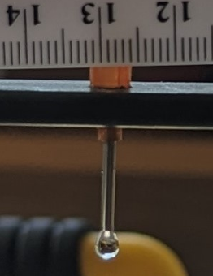
Experiment Setup
Syringe and nozzle
The setup was extremely simple, consisting of a wooden jig which held a high-speed camera level to a smooth aluminum plate.
A wooden strut held a syringe and nozzle which allowed for the careful dropping of single droplets.
A light source was held behind the droplet in order to improve the visibility of the droplet seen below. This lead to improved edge detection in Matlab.
Smooth Plate
High Speed Camera
Experimental setup

Slide 7
Edge Processing
I used an in-built edge detection method in Matlab to find the edge of the droplet in each frame in a video taken by the high-speed camera.
The edge is initially processed as the below image.
Then the outside points are removed, and the edge is smoothed to create a well-defined boundary.
This boundary can be imported into Python.

Slide 8
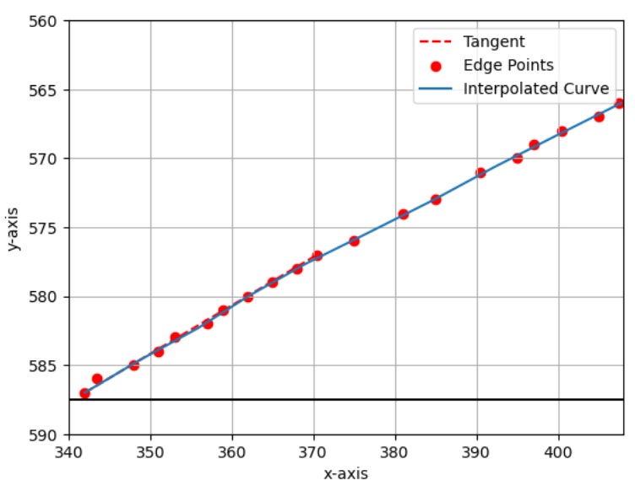
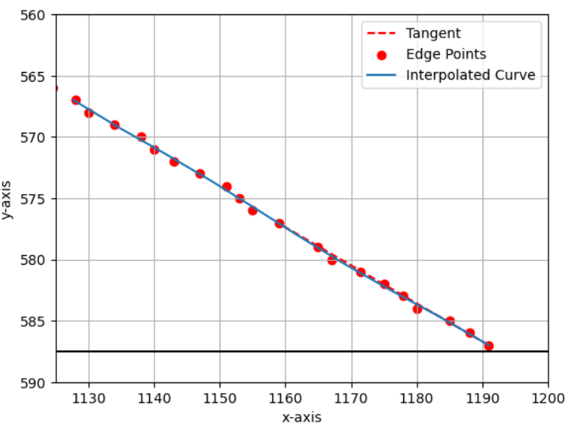
Contact Angle
Now that we have this boundary, a range of polynomials with different degrees are fitted to each side of the droplet.
The root-mean-square error is calculated for each degree and the polynomial with the lowest root-mean-square error is used.
The tangents to these curves are found meaning that the contact angle can be calculated easily at each frame.

Slide 9
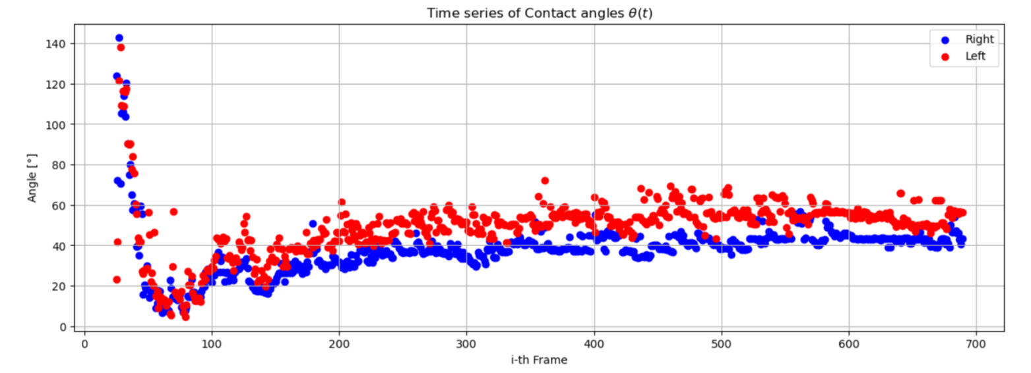
Contact Angle
Below shows the time series of the contact angle on the left side of the droplet (red) and the right side of the droplet (blue).
The oscillatory motion of the angle can be seen as it settles into its equilibrium value of approximately $θ_{e}=50°$.
The slight difference in behavior is counteracted by averaging the two angles.

Slide 10
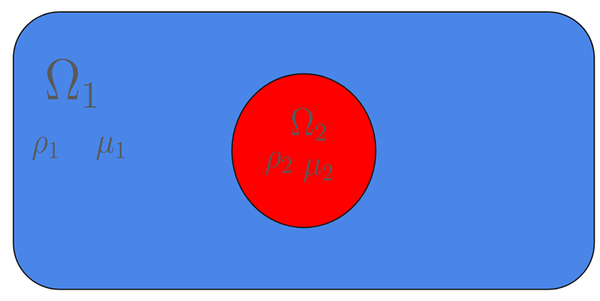
Simulation
Two-Phase Flow
Volume of Fluid
A water droplet falling in the air is an example of two-phase flow. The system is governed by the Navier-Stokes equations, one set for each phase:
$$ρ_{i}\frac{D\vec{u_{i}}}{Dt}=−\vec{∇}p_{i}+\vec{∇}⋅\left[μ_{i} \left( \vec{∇ }\vec{u_{i}}+\vec{∇}{ \vec{u_{i}}}^{T}\right)\right]+\vec{F_{b_{i}}}$$
$$\vec{∇}⋅\vec{u_{i}}=0$$
where i=1,2 denoting the phase and $\vec{F_{b_{i}}}$ are the body forces involved. The boundary conditions include the continuity of velocity, the continuity of tangential stress and the normal stress balanced by surface tension.
InterFoam is a solver used for two phase flow using the Volume of Fluid Method. It introduces the volume fraction as $χ(x,y,z)$:
$$χ\left(\vec{x}\right)=\left\{\begin{aligned}1 if \vec{x} is in phase 1 \\ 0 otherwise \end{aligned}\right.$$
We can use a smoothed volume fraction that is how much of phase 1 there is in a discrete volume:
$$α\left(\vec{x}\right)=\frac{1}{V} \int_{V}{χ\left(\vec{x}′\right) d^{3}\vec{x′}}$$
Redefine global density and global viscosity as a weighted average:
$$ρ\left(\vec{x}\right)=ρ_{1} α\left(\vec{x}\right)+ρ_{2}\left(1−α\left(\vec{x}\right) \right)$$
$$μ\left(\vec{x}\right)=μ_{1} α\left(\vec{x}\right)+μ_{2}\left(1−α\left(\vec{x}\right) \right)$$

Slide 11
Volume of Fluid
Navier-Stokes
We can rewrite the Navier-Stokes equations for the entire domain
$$ρ\left(\vec{x}\right)\frac{D\vec{u}}{Dt}=−\vec{∇}p+\vec{∇}⋅\left[μ\left(\vec{x}\right)\left( \vec{∇ }\vec{u}+\vec{∇}{ \vec{u}}^{T}\right)\right]−ρ\left(\vec{x}\right)g\hat{z}+\vec{F_{ST}}$$
$$\vec{∇}⋅\vec{u}=0$$
where $\vec{F_{ST}}$ is the force due to tension. This is particularly hard to calculate as it acts only on the interface.
For VOF we can treat it as a continuous body force acting on the whole domain which takes the form:
$$\vec{F_{ST}}=±γ \vec{∇}α\left( \vec{∇}⋅\left[ \frac{\vec{∇}α}{\left|\vec{∇}α\right|} \right] \right)$$
where $\left[ \frac{\vec{∇}α}{\left|\vec{∇}α\right|} \right]=cosθ$ with $θ$ is the contact angle. This can be substituted into the eqn. 1. From the conservation of mass and using that the fluids are incompressible we can show that:
$$\frac{Dα}{Dt}=0$$
Equations 1 and 2 are solved by interFoam numerically using the boundary conditions.
Eqn. 1
Eqn. 2

Slide 12
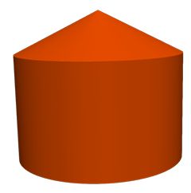
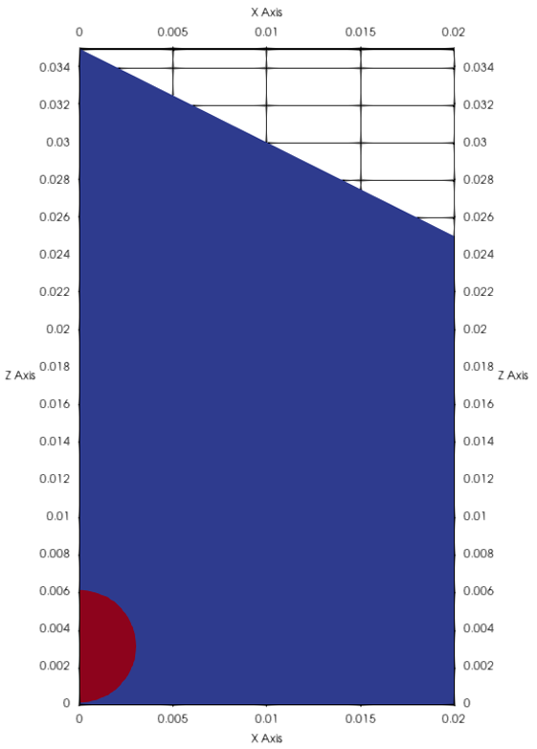
Simulation Setup
Mesh:
The blockMesh defines the simulation domain and splits it into a grid of cubes where the two equations are solved.
The dimensions were found by Conor to capture the important characteristics of the impact whilst minimizing computational time.
The points of the domain were chosen to be as shown in the 2D image.
Droplet:
The water droplet is defined to have a velocity of $U=\left(0,0,−1\right)$m/s and radius of 0.003m.
The simulation is performed between t=0 and t=0.35seconds with an adjustable time step allowing the model to save on computational time.
Narrow Wedge
Rotational Extrusion

Slide 13
Constant Contact Angle
Conor’s previous simulations used a constant contact model in OpenFoam with an angle of 90˚.
This particular simulation is ran up to t = 0.07seconds as after this it becomes unphysical.
BlockMesh of (600 1 900). Corresponds to the number of cubes in each direction so theres 600 cubes in the x directoon., 1 cube in the y direction and 900 cubes in the z direction.
This took around 7 days for Conor to run on his laptop.
Maximum Spreading =0.0115m

Slide 14
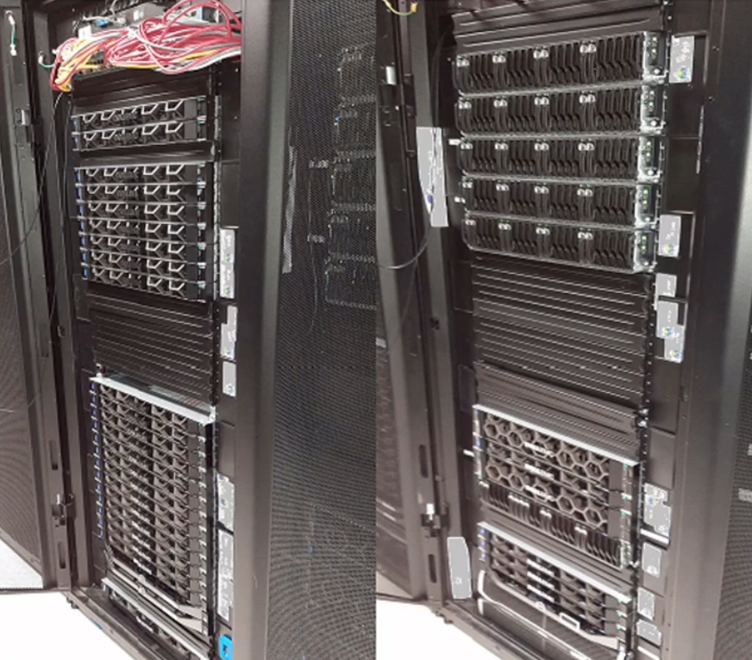
Sonic HPC
Conor’s previous 3D simulations implemented a constant contact angle to save on computation time. The dynamic contact angle would take too long for his 8-core laptop.
To help with the computation time this project allowed me to use the Sonic HPC cluster in UCD.
Thus, we could submit the simulations to be run on the Sonic servers which meant that I could run simulations on up to 45 cores which greatly improved the run time.
Sonic HPC Cluster

Slide 15
Dynamic Contact Angle
The Sonic cluster meant that we could now newly introduce the dynamic contact angle into the 3D model which previously only used a constant contact angle.
In OpenFoam the dynamic contact angle follows the following equation:
$$θ=θ_{e}+\left(θ_{a}−θ_{r}\right)tanh\frac{U_{wall}}{U_{θ}}$$
where $U_{wall}$ is an approximation of the velocity at the contact line, $U_{θ}$ is a parameter without a clear physical meaning. Thus, the dynamic angle then varies between $θ=θ_{e}±\left(θ_{a}−θ_{r}\right)$.
From our previous experimental measurements, we found approximately that:
These values are implemented inside the 3D model to provide a more realistic simulation. We can visualise the simulation best by rotating the wedge by 180˚.
Angle | Value
$$θ_{e}$$ | 50˚
$$θ_{a}$$ | 55˚
$$θ_{r}$$ | 45˚

Slide 16
Dynamic Contact Angle
Dynamic Contact Angle with $U_{θ}=6.155$. This is the value that Juan found made the simulations match best with what we would expect.
The BlockMesh was (400 1 600).
Ran on 40 cores for about 20 hours.
Maximum Spreading =0.014m

Slide 17
Dynamic Contact Angle
We can also check the effect the value of $U_{θ}$ by performing simulations with a larger (18) and smaller (1) value of $U_{θ}$.
Same blockMesh as before
They were both ran on 40 cores for about 20 hours.
$$U_{θ}=1$$
$$U_{θ}=18$$
Maximum Spreading =0.0142m
Maximum Spreading =0.014m

Slide 18
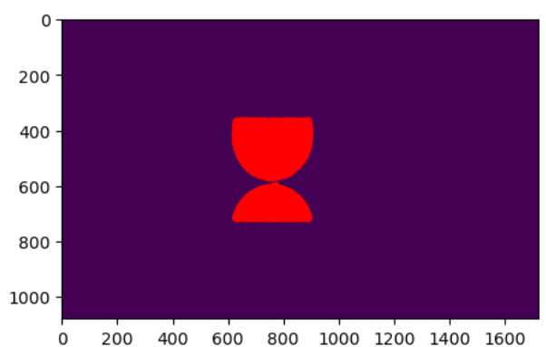
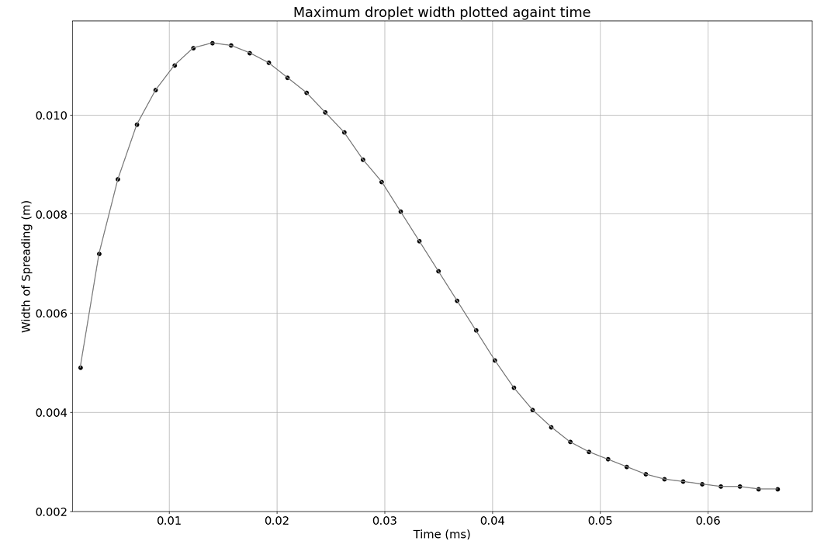
Maximum Spreading
Experiment
Simulation
From the edge detection we can find the radius of the droplet on the python scale. We have previously approximated the droplet radius to be 0.003m
We can find the python scale for the maximum spread frame.
Thus, we use the previous scaling to calculate the real-world measurement which is approximately 0.0018m
The maximum spreading of the simulations can also be found.
Using the dynamic angle model brings the maximum spreading closer to the “true” value found from the experiment.
Simulation | Max. Spreading [m]
$$Constant angle$$ | 0.00115
$Dynamic$angle | 0.0014

Slide 19
Conclusions
Summary of Results
What I have learned
We have accurately measured the contact angle varying over time in an experiment.
The measured values have been added to the 3D simulation using the dynamic contact angle model in OpenFoam.
We have shown the split up of the droplet due to a numerical error caused by the thinness of the water at this point.
We have improved the maximum spreading value to be closer to what is seen in experiment.
I learned how to use OpenFoam through the linux terminal with Ubuntu.
I became familiar with edge processing in Matlab which I had never seen before.
I gained experience with the high-performance computer in UCD and I learned how to submit jobs and manage the submissions neatly.
Main Point
We have built on previous work to improve the realism of the droplet impact simulation.

Slide 20
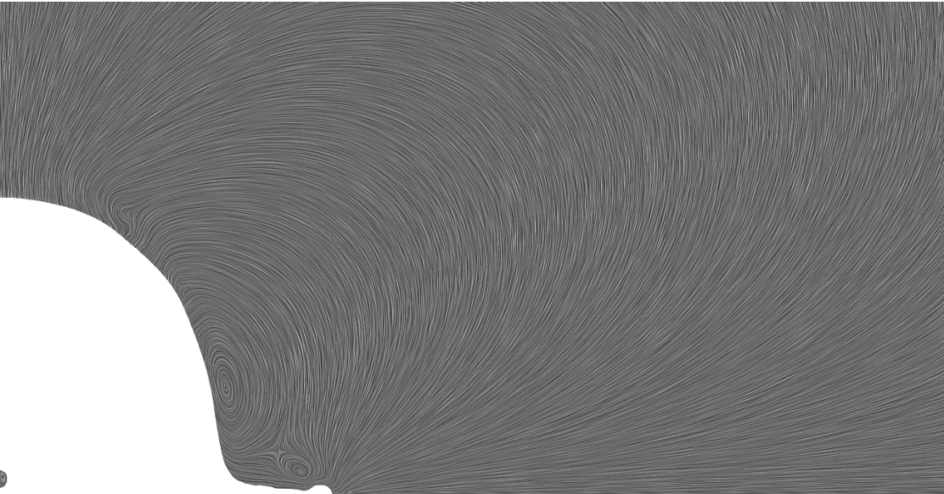
Further Research
The project has been left in a good place where another student could continue on from. The Sonic cluster will mean that future students will be able to run and test simulations quicker and easier. Some potential avenues for further research include:
Visualising the flow inside the droplet could lead to an improved understanding of the dynamics within the droplet.
A dynamic meshing could be used to try to prevent the numerical error caused by the thin droplet surface. This could lead to an even more realistic model.
A local mesh generation with a high resolution could be used on the area of the droplet where the numerical error occurs.
Flow Visualisation from Conor’s thesis

Slide 21
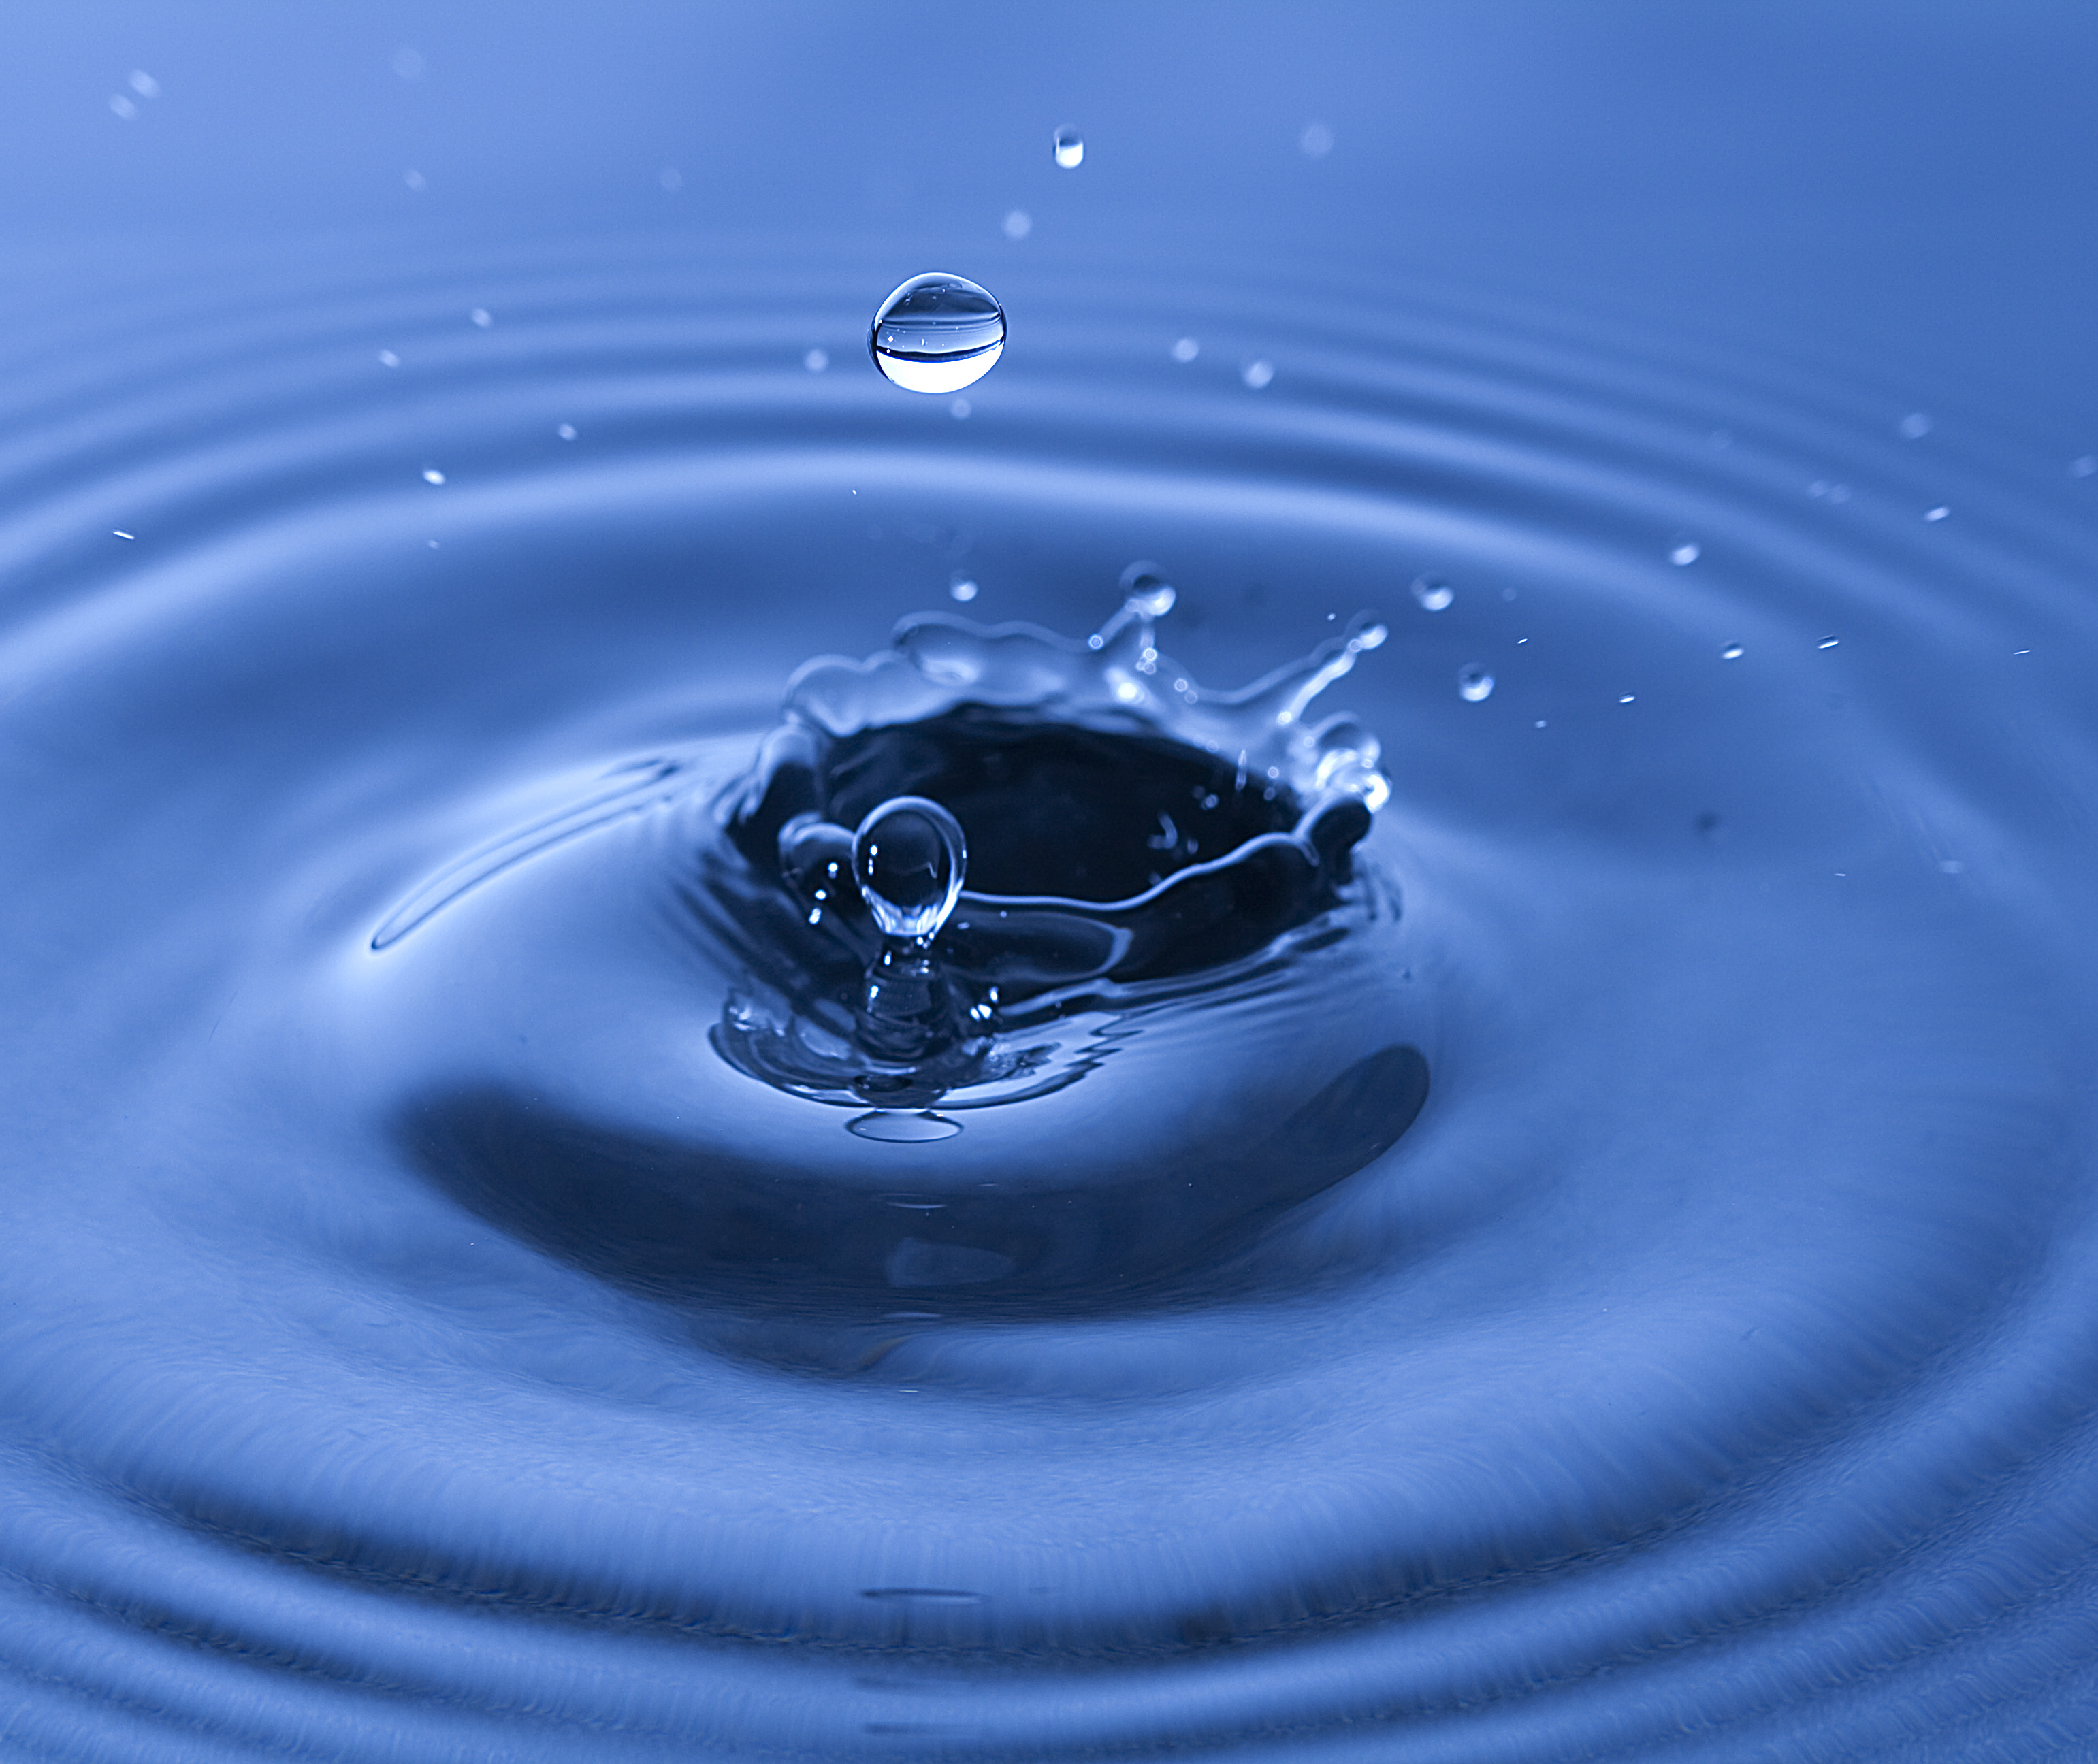
Thank you!
I hope you enjoyed my presentation.

